Slide 1
Brain activation in response to urinary bladder filling in spinal cord injured patients: a fMRI study
Jaroslav Tintěra¹, Jan Krhut²,
Petr Holý³, Karolína Bílková⁴, Roman Zachoval³
¹ Institute for Clinical and Experimental Medicine Prague, Czech Republic
² Department of Urology, University Hospital Ostrava, Czech Republic
³ Department of Urology, Thomayer’s Hospital, Prague, Czech Republic
⁴ Spinal Cord Rehabilitation Unit, Rehabilitation Center Kladruby, CR

Slide 2
Aim of the study
Our understanding of the neuroregulation of the urinary bladder is still incomplete
It has been recognized that many of diseases associated with lower urinary tract and altered bladder emptying could have their origin in the dysfunction at the level of CNS
Little is known about the extraspinal afferent pathways in human
The aim of the study was to evaluate the extraspinal sensory pathways in spinal cord injured patients using fMRI

Slide 3
Methods: group of patients
Subjects: 12 right-handed men (age 24–54 years) were enrolled. All patients experienced complete spinal cord injury (ASIA A) at level C7-Th 5 on average 15 months before entering the study.
General conditions
  informed consent
  all examinations in antibiotic profylaction (ofloxacin 2x 200 mg)
  bladder and abdominal pressure monitoring
fMRI protocol
  filling and withdrawing of the bladder with simoultaneous
  fMRI and urodynamics measurement

Slide 4
Methods: urinary tract interventions
Filling and withdrawing of the bladder:
  application of a double-lumen, soft 8 Fr bladder catheter
  intravesical pressure monitored during repeated filling
  intraabdominal pressure measured in the rectal ampula
  pressure and filling monitored using urodynamical system MMS
Filling dynamics
  filling rate 25 ml/min up to a) 50 ml and b) 100 ml
  at level a) and b): cyclic filling and withdrawing of 25 ml
  then the bladder was filled until uninhibited detrusor contraction has been occurred
  this procedure repeated 3x

Slide 5
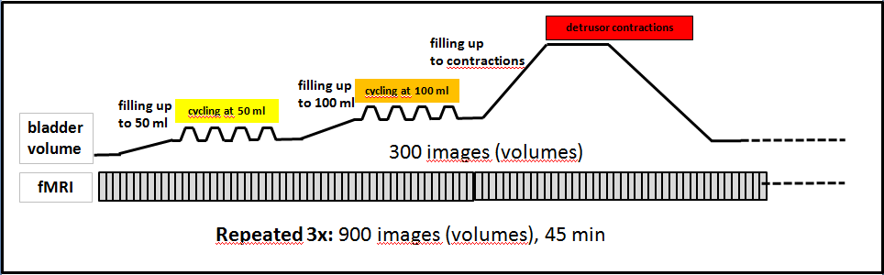
Methods: urinary tract interventions
Cyclic bladder filling and withdrawing scheme

Slide 6
Methods: fMRI experiment
magnet room
P
MMS
urodynamic
system
magnet
F
P – pressure monitor
F – filling pump
D– data-projector
MR system: Siemens Trio Tim 3T
Sequence: GRE EPI
        TE 30 ms, TR 3 s, BW 1594 Hz/px, PAT 2
        45 slices, voxel 3 x 3 x 3 mm, MA 64 x 64
        900 dynamics, acquisition time 45 min

Slide 7
Methods: evaluation
Software: SPM 8
Pre-process (SPM):
        realignment
        slice timing
        smoothing: 6 x 6 x 6 mm
        normalization
Statistics:
All blocks with bladder manipulation including the episode
of detrusor contraction were defined as one condition
Individual and group statistics:
t-test, p=0.001 uncorrected

Slide 8
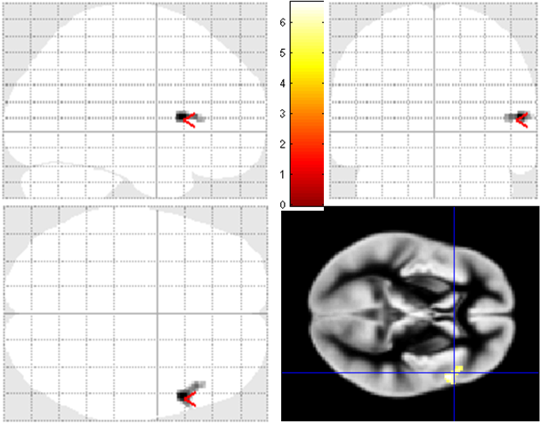
Results
In 7 of 12 our patients we were able get any brain response.
In 5 cases either high level of motion artifacts caused by muscle spasms
or unpredictable bladder reaction did not allow to recognize any activation.
Group statistics of 7 successful fMRI examinations
right triangular part of the inferior frontal gyrus
[54, 14, 8]
Group level, p=0.001 unc.
min. 8 voxels

Slide 9
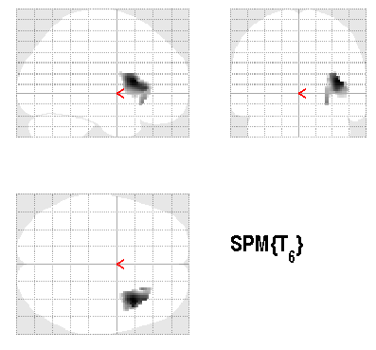
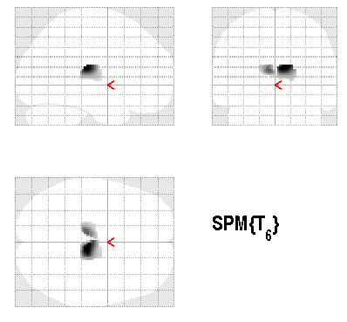
Results
Group level, p=0.05 unc.
min. 8 voxels
masked
insula
thalamus

Slide 10
Results
individual level: selected masked areas
patient | NTS | parabrachial region | thalamus | amygdala | insula | anter. cingulum | prefront cortex
1 | * | * | * |  |  | * | *
2 |  | * | * | * | * | * | *
3 | * | * | * | * | * | * | *
4
5 |  |  |  |  | * | * | *
6 |  |  |  |  | *
7 | * | * | * |  | * | * | *
8 | * | * |  |  |  |  | *
9
10
11
12
Individual level, p=0.001 unc.
min. 8 voxels

Slide 11
Results
individual level: selected masked areas
NTS: 4 (33%)
Parabrachial: 5 (42%)
Thalamus: 4 (33%)
Amygdala: 3 (25%)
Insula: 5 (42%)
Anterior cingulate: 5 (42%)
Prefrontal cortex: 7 (58%)

Slide 12
Discussion
Limited number of subjects → still limited statistical significance on group level (p=0.001)
Low and heterogeneous activation
Activation in problematic region (susceptibility and motion artifacts)
Our data provide strong evidence that both spinal and extraspinal sensory pathways are involved in the neural control of the lower urinary tract.
Supported by IGA-CZ NT14183-3/2013.

